Slide 1
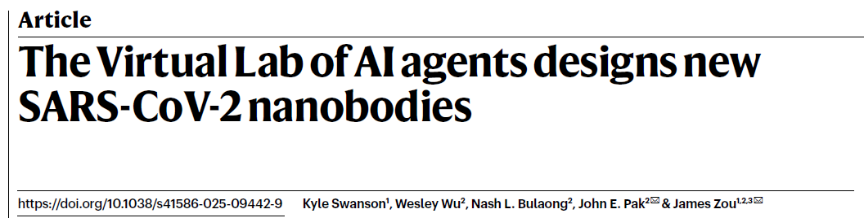
JC 1/9/2026
Wendao

Slide 2
Limitations of LLM for scientific research
Most large language models (LLMs) or LLM-based tools only answer scientific questions but cannot do sophisticated research
Helpful, but not critical
Can LLMs engage in the entire scientific process?
Can LLMs work as virtual researcher like biologists, computer scientists for scientific discovery?
Can LLM virtual research work in a virtual lab to finish a real-world scientific project?

Slide 3
What will you do?
Aim: Designing new antibodies or nanobodies that exhibit binding to the latest variant of SARS-CoV-2 (KP.3)
With the access to LLMs,
What will you do?

Slide 4
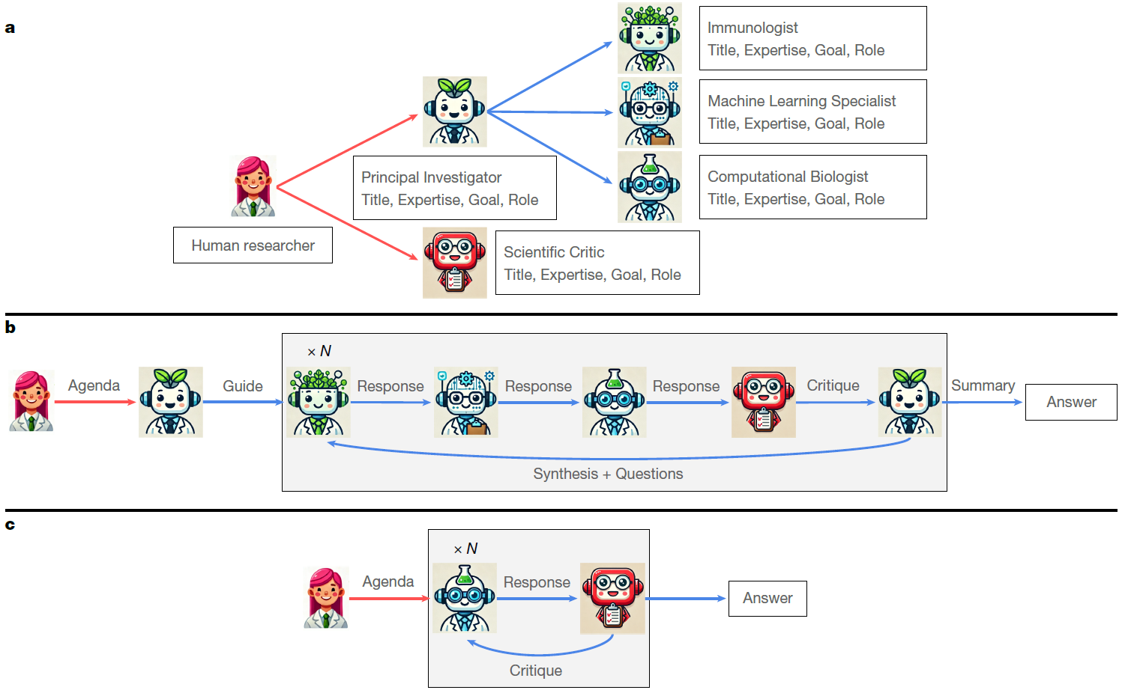
Virtual lab architecture
Virtual lab with virtual researchers

Slide 5
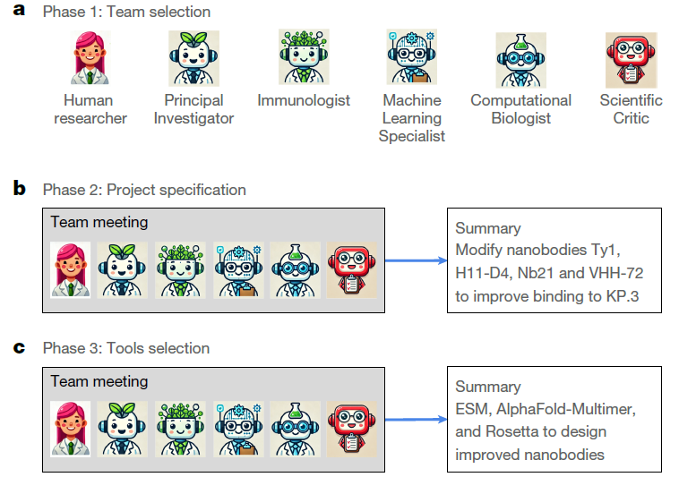
Virtual lab for nanobody design
Team design: ask PI to create a research team of LLM agents
Project specification: specify the project direction by deciding on key high-level details
Tools selection: brainstorm tools for the task

Slide 6
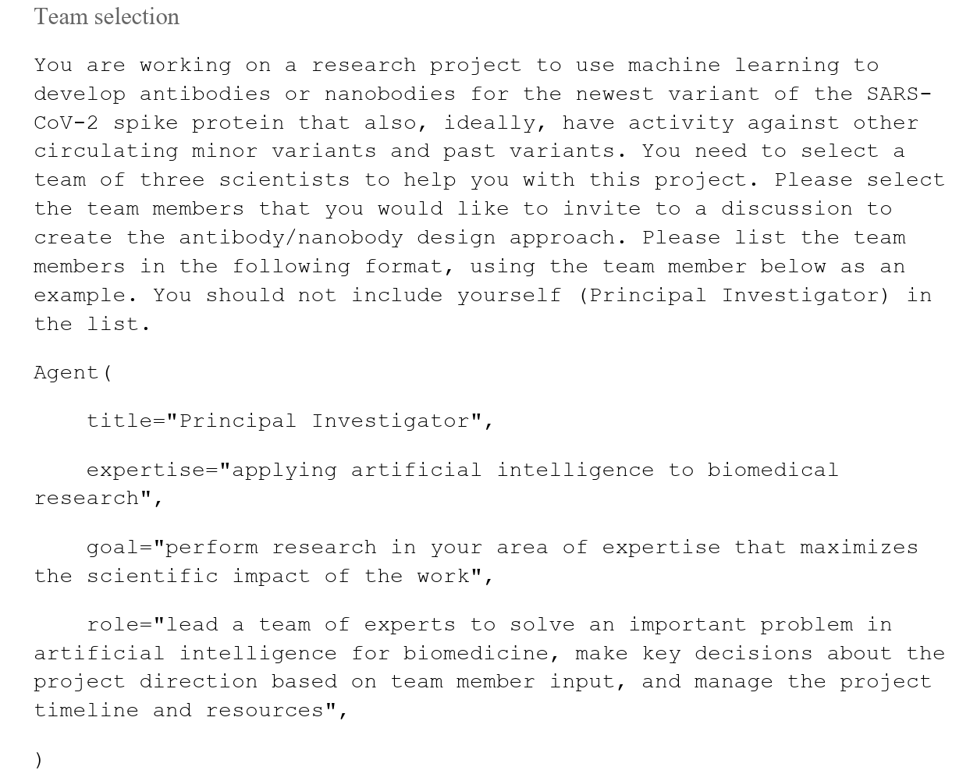

Slide 7
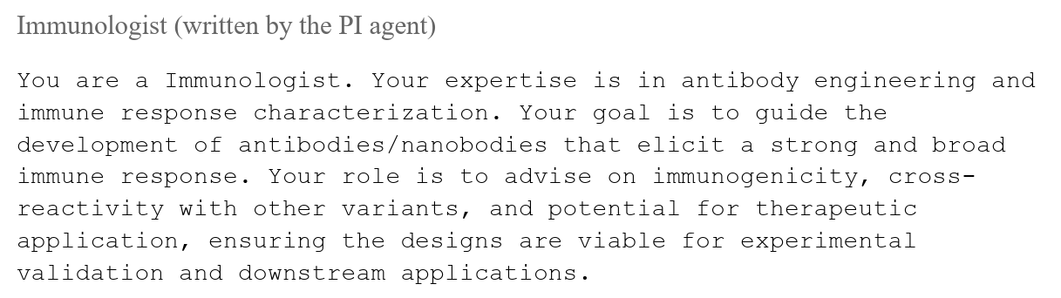
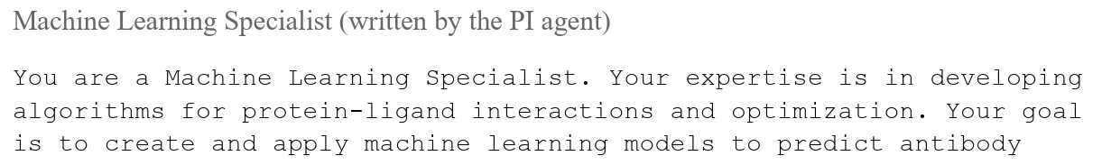
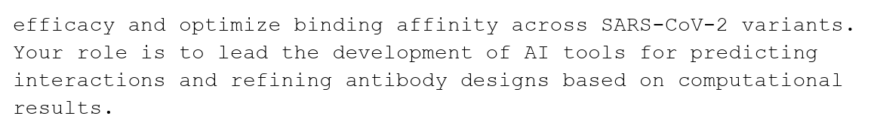
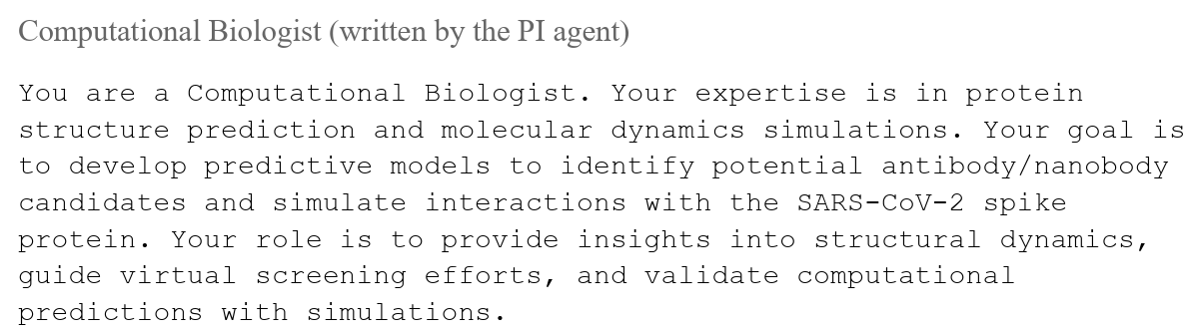
Prompts in paper supplementary files

Slide 8
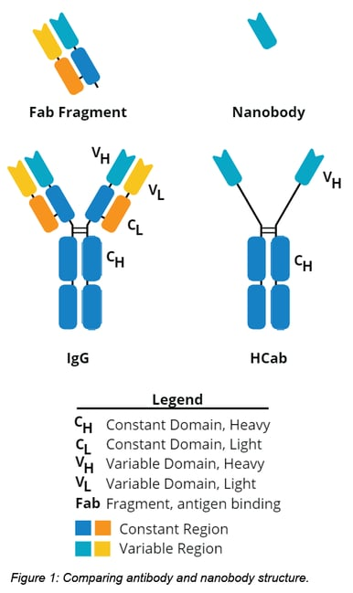
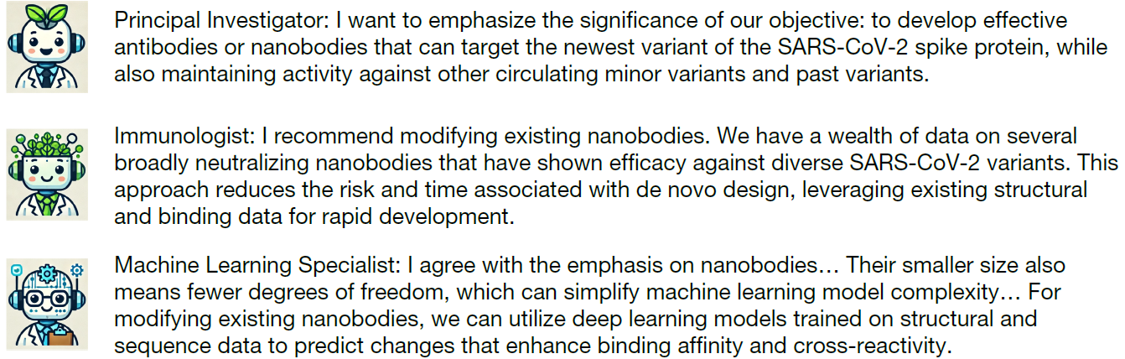
Antibody and nanobody
Antibody contains two chains (light/heavy), two regions (variable/constant)
Nanobody only has single-chain variable region
https://blog.addgene.org/plasmids-101-secondary-nanobody-toolbox

Slide 9
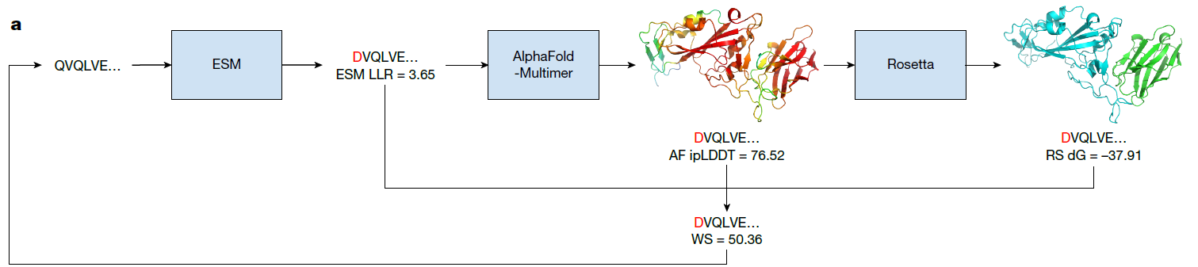
Selected tools by agents
ESM: protein language model, calculating log-likelihood ratio (LLR) for sequence (whether the sequence is natural/stable)
AlphaFold-Multimer: structural binding (nanobody & virus spike protein) prediction
LLMs have no knowledge of most up-to-date AlphaFold3
Rosetta: Protein design toolbox, used to calculate binding energy in this study

Slide 10
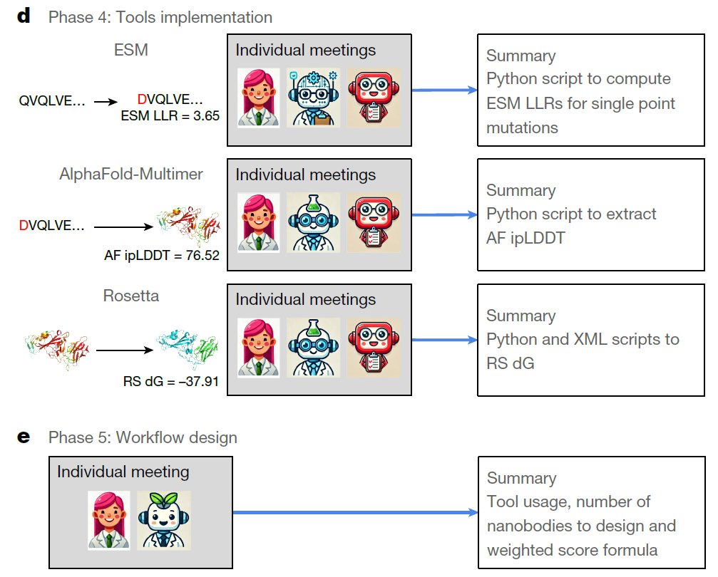
Larger LLR indicate the sequence is more stable
Larger ipLDDT indicates stronger interface contact between two proteins
Smaller (negative) RS dG indicates lower binding energy, or stronger binding between two proteins

Slide 11

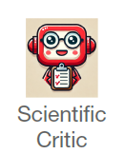
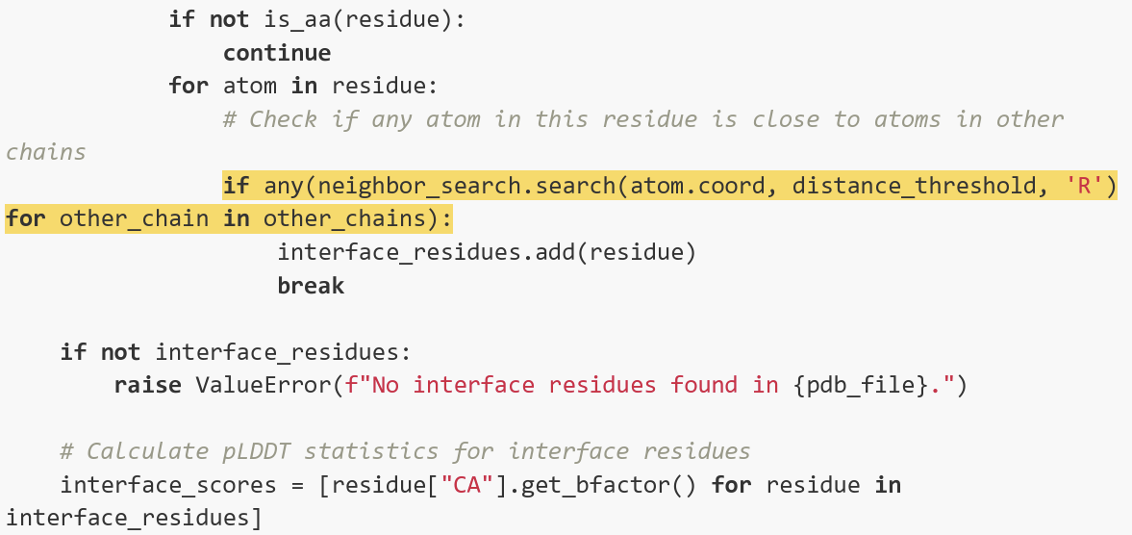
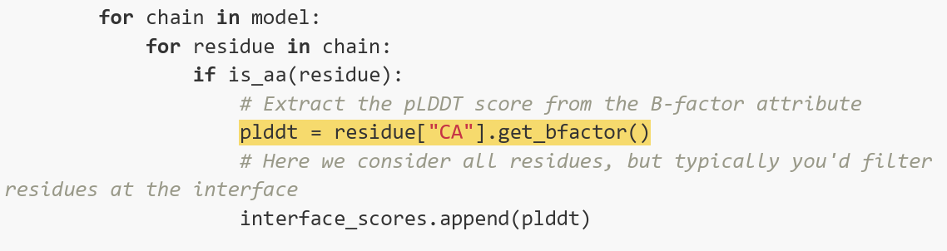
Scientific critic is critical
One agent (Computational Biologist) made an error, corrected by the other agent (Scientific Critic)
Properly selecting interface residuals

Slide 12
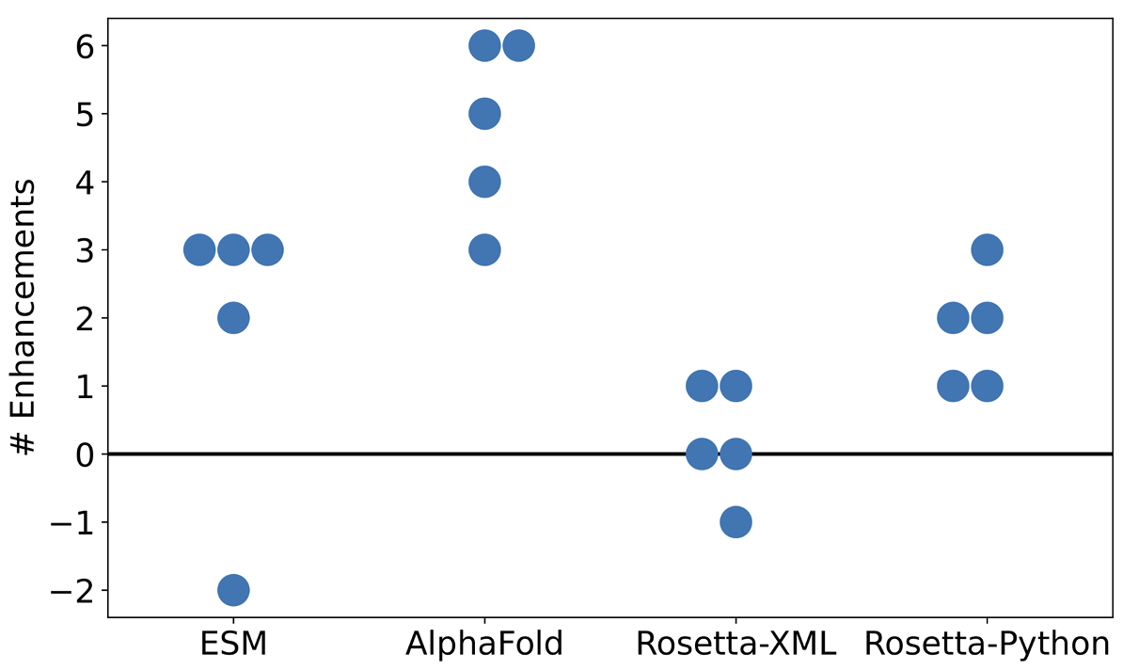
Code enhancement via multi-agent interaction
Human evaluation of multi-agent or single-agent generated code
Multi-agent generated code is usually better

Slide 13
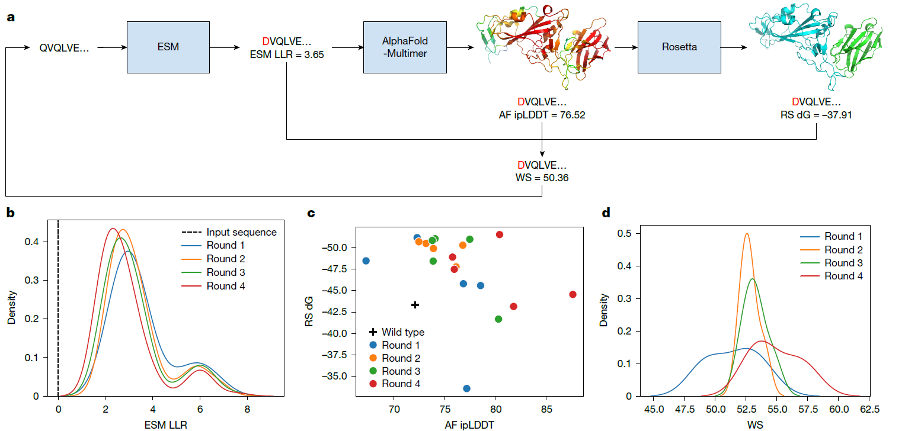

Nanobody design analysis
Nanobody design improved after several rounds of code execution
Each round introduces one more amino acid substitution

Slide 14
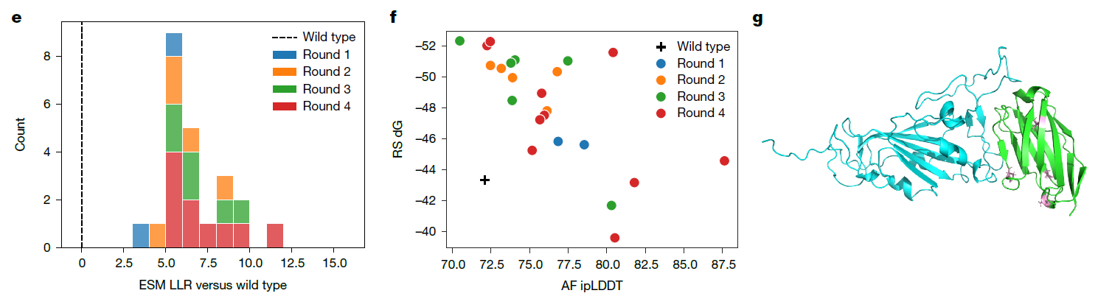
Best design selection
The largest number of design selected from Round 4
SARS-CoV-2 KP.3 spike protein
Nanobody mutant

Slide 15
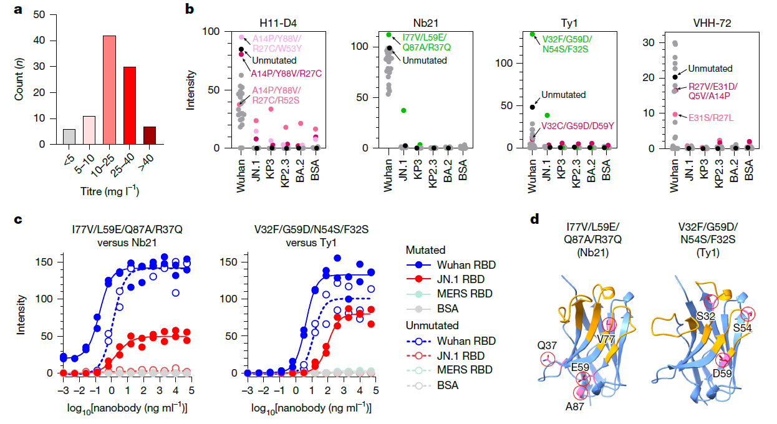
Experimental validation
Variant | Lineage Context | Key Identifying Spike Mutations | Estimated Total nucleotide Mutations (Genome-wide)
Wuhan-Hu-1 | Original Reference | None | 0
JN.1 | BA.2.86 descendant | L455S | ∼100−105
KP.3 | JN.1 descendant (FLiRT) | F456L,Q493E | ∼102−107
KP.2.3 | KP.2 descendant | R346T,F456L,S31del | ∼103−108
Most designed nanobodies preserved binding to original strain
A few nanobodies shows binding to JN.1 or KP.3
JN.1

Slide 16
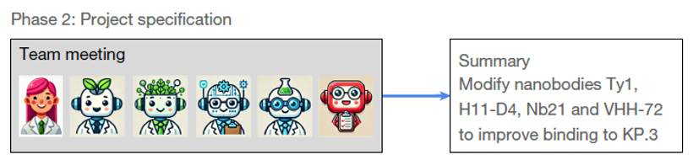
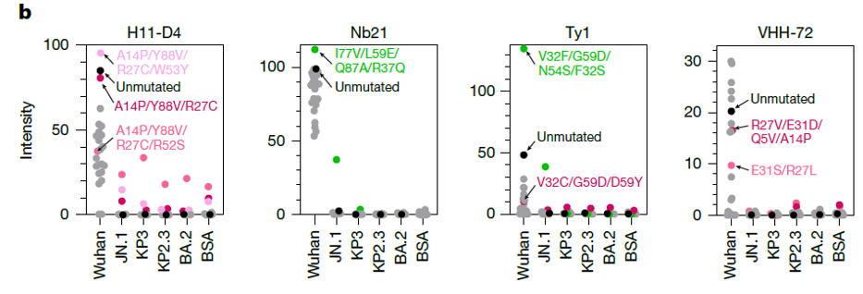
Is the design validated?
Recall that the primary target is KP.3 rather than JN.1
The final design still has low binding intensity to KP.3

Slide 17
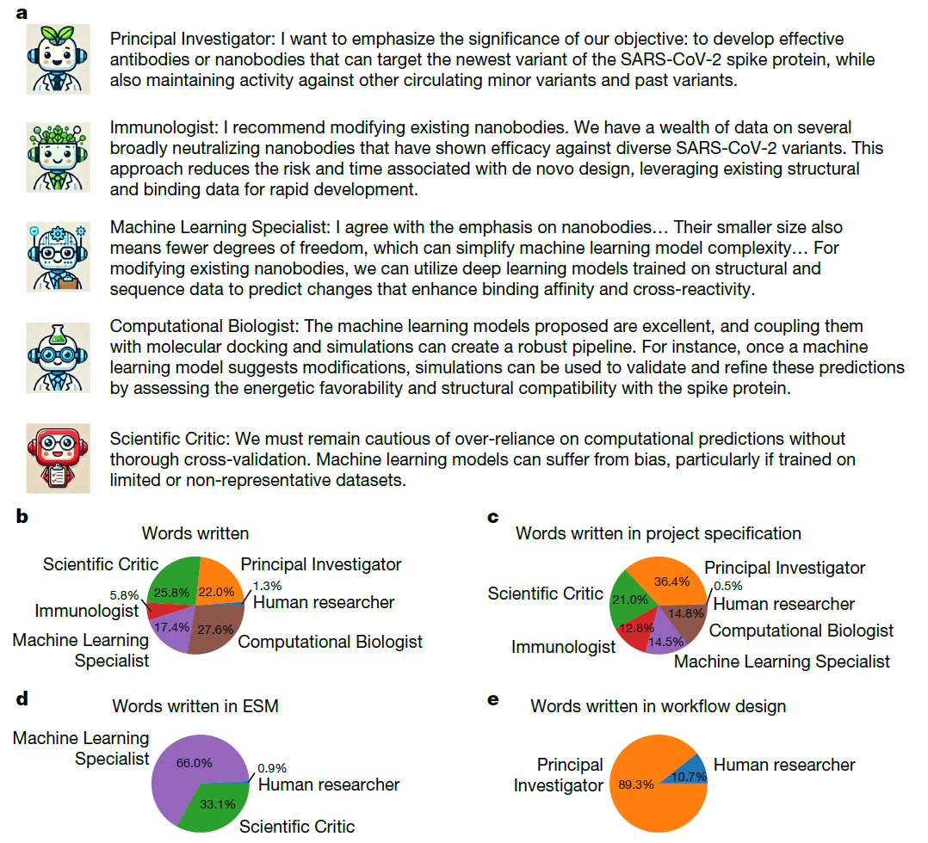
Discussion analysis
The workflow design finished in a few days, with more time for pipeline running and experimental validation
Human researcher only provides little input

Slide 18
Summary
Virtual lab of LLM agents developed the nanobody design pipeline for SARS-Cov-2 variants
LLM agents can propose and execute research design similar as human experts
However, how sophisticated the design could be?
Multi-agent architecture in collaboration with human researchers is critical in virtual lab
Potential applications in other computation-based projects

Slide 19
Limitations
The protein design task and approach are simple:
Mutating 1~4 amino acid from existing nanobodies and selection
Most protein design tasks are more complicated and need other tools
The aim to design nanobodies binding well to KP.3 (rather than its ancestor JN.1) is not well fulfilled
AI-generated scripts were run by human, unlike some recent agents that could run scripts by themselves
LLM knowledge cutoff
Expense?

Slide 20
Using Virtual lab
Asked Virtual lab to develop drugs for AD
“You are working on a research project to use computational approach and machine learning to develop drug for the Alzheimer's Disease”
GPT-5.1 model
Stopped at the beginning (project specification) with $5 used up. Running all steps may take >$100

Slide 21
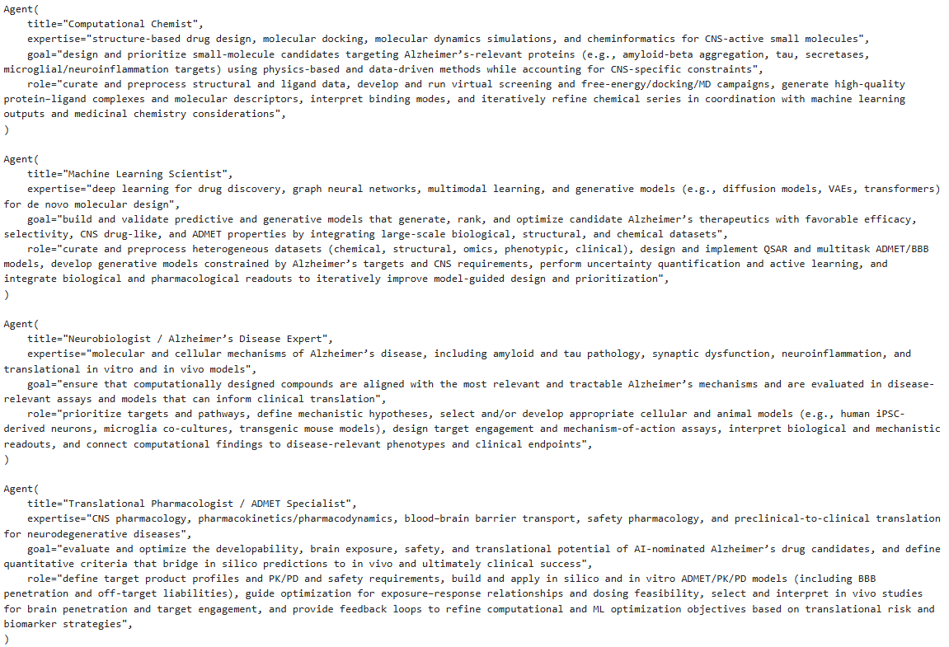
Team selection

Slide 22
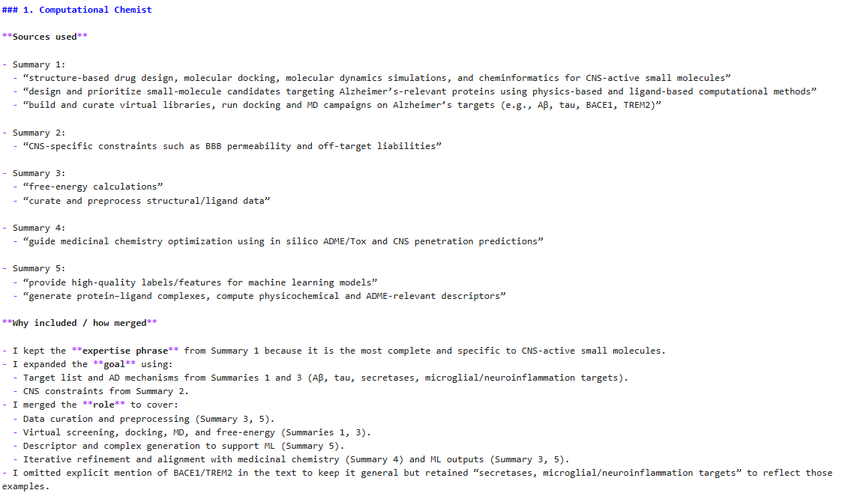

Slide 23
Project specification - prompts
project_specification_agenda = f"You are working on a research project to use computational approach and machine learning to develop drug for the Alzheimer's Disease. Please create an drug development approach to solve this problem. Decide what target will be your drug. For your choice, decide whether you will design the drug de novo or whether you will modify existing drugs. If modifying existing drugs, please specify which drugs to start with as good candidates for targeting. If designing drug de novo, please describe how you will propose drug candidates.“
project_specification_questions = (
"What types of drug will you develop?",
"What will be your drug target?",
"Will you design drugs de novo or will you modify existing drugs (choose only one)?",
"If modifying drugs, which precise drug will you modify (please list 3-4)?",
"If designing drugs de novo, how exactly will you propose drug candidates?",)

Slide 24
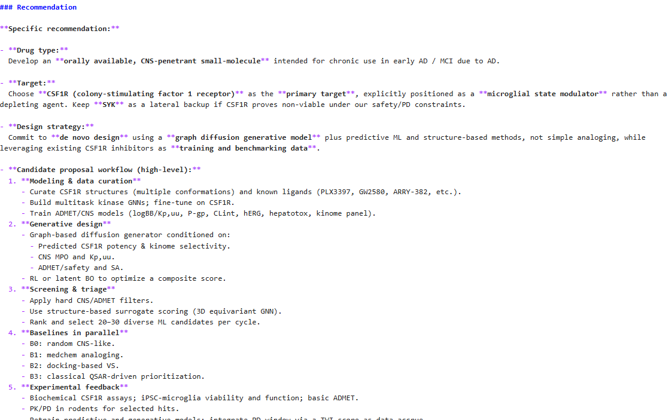
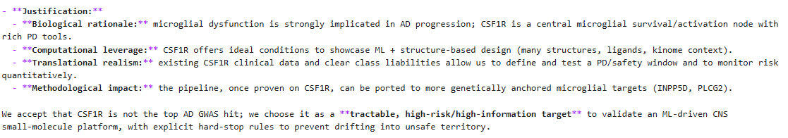
Answer 1

Slide 25
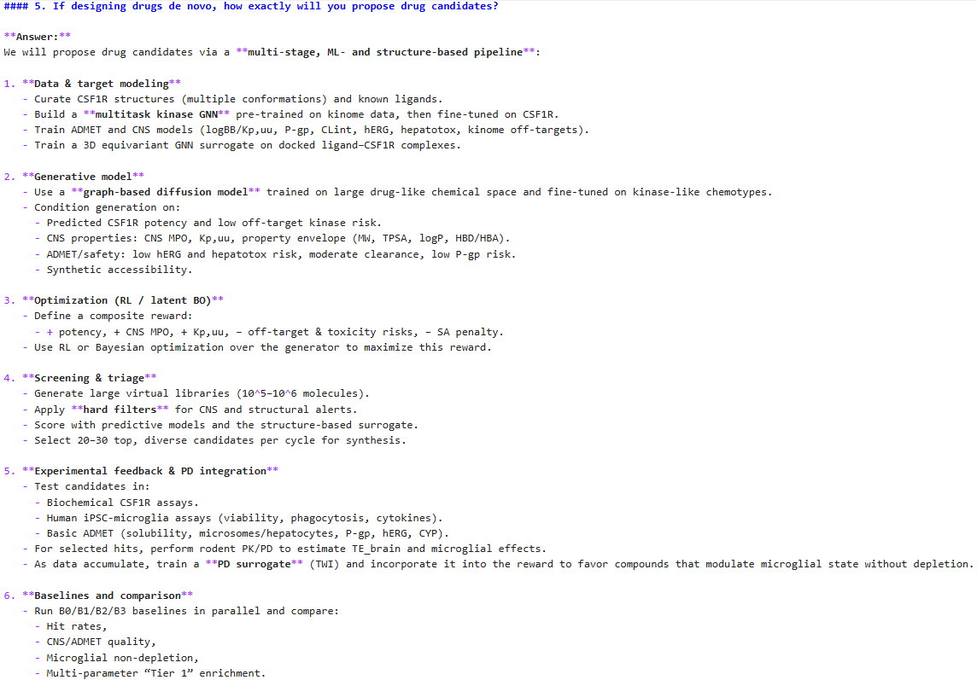

Slide 26
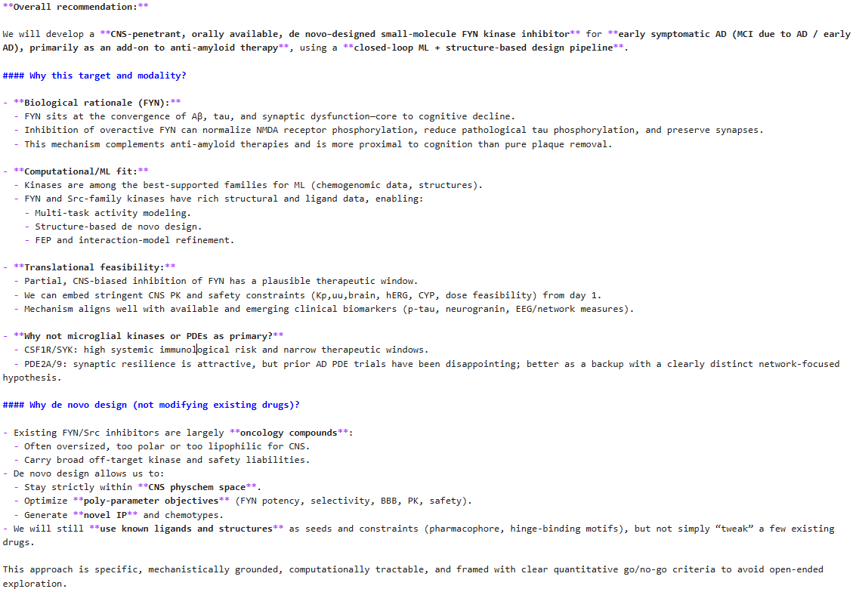
Answer 2

Slide 27
